Slide 1

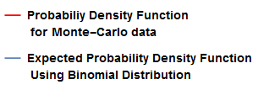
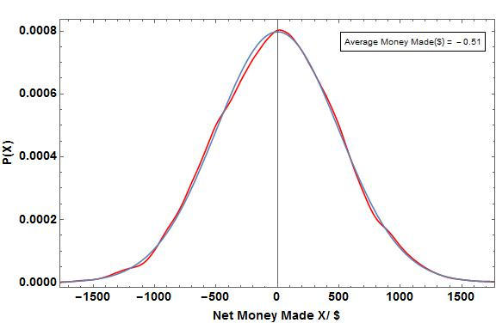
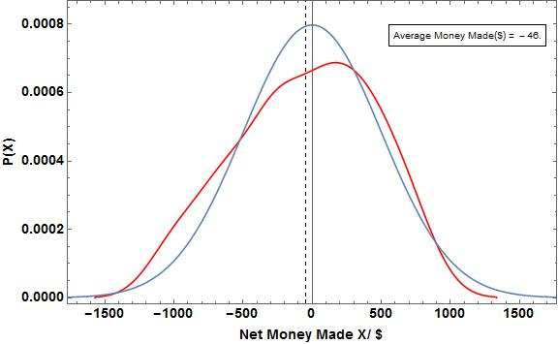
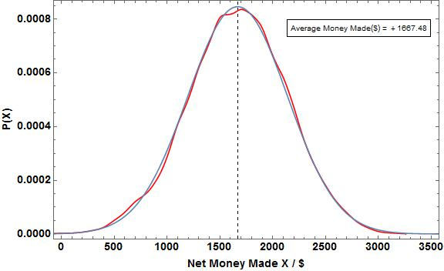
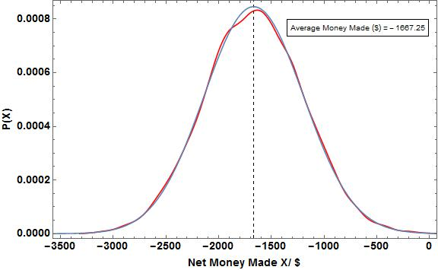
The Gambler’s Ruin: Mathematics of Gambling
Omair Alam, Computational Methods in Physics, Spring 2015
Introduction:
Gamblers know that there are regular patterns to chance—although not all of their cherished beliefs survive mathematical analysis. In order to test the validity of their beliefs we using Monte-Carlo simulations to calculate the average earnings or losses in a game of die rolls under varying rules of winning. We further simulate a game of Craps with both a biased and unbiased die. For a dice roll game, we use a Binomial Distribution to model the expected earnings while for a Craps game, we use axiomatic derivations to calculate the expected probability of winning. We then compare the expected earnings with the actual earnings for a varying number of repetitions to understand the fate of the Gambler’s money after betting under certain game rules repeatedly.
Plots For Roll Die Game consisting of Expected and
Monte- Carlo Data
Legend
Figure 1: Probability Distribution for a roll die game with a Fair Dye i.e. P(W) = P(L) for 10,000 repetitions of a game which consists of 100 trials. The Base Amount is $40,000, the score per win is $50, The lower-bound amount is $20,000 and the upper-bound amount is $80,000
Figure 2: Probability Distribution for a roll die game with a Fair Dye i.e. P(W) = P(L) 100 repetitions of a game which consists of 100 trials. The Base Amount is $40,000, the score per win is $50, The lower-bound amount is $20,000 and the upper-bound amount is $80,000
Physics and Methods:
Monte-Carlo methods were used as computational algorithms to approximate the probability of certain outcomes by running multiple trial runs using random variables.
We conducted two sets of experiments of which the first is related to rolling a die and the second is related to playing a game of Craps.
The rules of the die roll game are as follows:
We start with a base amount i.e. the money we start the game with,
Every roll, if we get a favorable score, we gain a certain amount x, otherwise, we lose the same amount x,
We keep playing till we
Either get a net amount greater than a certain upper-bound amount Z representing having made enough to cash-out.
Or get a net amount lesser than a certain lower-bound amount Y representing having lost so much that more gambling isn’t possible
Or if we exhaust the number of trails per game representing not having more time to play.
Net Amount is defined as,
Net Amount = The Score of Each Game – base Amount
We find the frequencies of each net amount, and normalizing the data to get the probabilities of attaining each net amount as well as the average earing.
We use the following Normal Distribution Formula in order to find the expected earnings for each Net Amount.
The rules of the Simulation for a single game of Craps are as follows:
If the sum of the two dies, X, is 7 or 11 we in the game
If X 2, 3 or 12, we lose the game
In X has any other value, we keep rolling two dies again till we either match that value of X again in which case we win, or we get a value of 7 for X, in which case we lose.
We simulate this game using both a fair and unfair die and calculate the probability of winning. We use an axiomatic derivation to calculate the expected probability of winning in both cases and compare these values.
Figure 5. Figure caption should give enough detail to describe the figure above with out reading much else
Figure 3: Probability Distribution for a roll die game with an Unfair Dye i.e. P(W) = 4/6 and P(L) = 2/6 10,000 repetitions of a game which consists of 100 trials. The Base Amount is $40,000, the score per win is $50, The lower-bound amount is $20,000 and the upper-bound amount is $80,000
Figure 4: Probability Distribution for a roll die game with an unfair Dye i.e. P(W) = 2/6, P(L) = 4/6 10,000 repetitions of a game which consists of 100 trials. The Base Amount is $40,000, the score per win is $50, The lower-bound amount is $20,000 and the upper-bound amount is $80,000
Table Of Expected Values for Craps Expected and
Monte- Carlo Data
Number of Trials | Estimated Probability of winning with Fair Die | Expected Probability of winning with fair Die | Estimated Probability of winning with Unfair Die | Expected Probability of winning with Unfair Die
10 | 0.600 | 0.493 | 0.800 | 0.524
10000 | 0.498 | 0.493 | 0.532 | 0.524
100000 | 0.491 | 0.493 | 0.524 | 0.524
Figure 6. Figure caption should give enough detail to describe the figure above with out reading much else
Conclusions or Discussion:
Give an overall conclusion of your results. What do they show. Is there agreement with experimental data? Or observation? What is the big picture. Include any problems, corrections and limitations to you code. Interesting next steps…
Table 1: The Fair die has equal probability of 1,2,3,4,5 and 6.
The unfair die has P(1) = 1/13, P(2) = 2/13, P(3) / 2/13, P(4) = 2/13, P(5) = 2/13 and P(6) = 4/13
Results:
In Figure 1-4, the average money which is the physical mean of the data, represents the weighted average of all the Net Sums, X, made after each game (which consists of 100 trials). For Figure 1, the average money made is very close to $0 because we used a fair die so using the Law of Large numbers, we will on average lose and gain an equal amount of money, resulting in an average net amount being very close to 0. For Figure 3, the average money is a big negative number, because the probability of losing is twice that of winning. For Figure 4, the average money is a big positive number, because the probability of winning is twice that of losing.
References:
Text 1 that was used
Article 2 that was used
Reference 3 that was use

